Slide 1

Exploring Web Development with Python: A Comprehensive Study with Applications (Blog) Built in Flask and Django School of Computing, Engineering & Physical Sciences BSc (Honours) Web And Mobile Development Supervisor: Tony Gurney Moderator: Pablo Salva Garcia

Slide 2


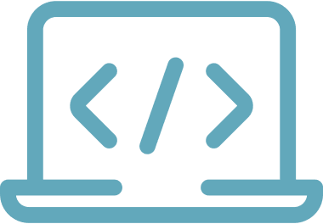

Why Python for Web Development?
Readability and syntax
Extensive libraries and frameworks
Community support
Versatility
Python's clean, readable syntax makes it easy to express concepts in less code
Vibrant community provides abundant resources and packages
Python can be used for both front-end and back-end development
Leverage tools like Flask and Django to handle common web dev tasks
With its simplicity, versatility, and robust ecosystem, Python is a great choice for web development.

Slide 3

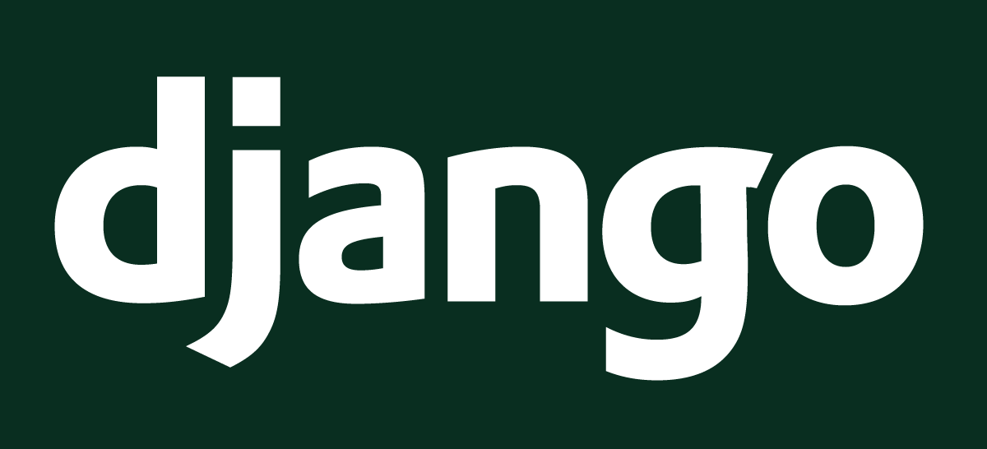
Flask and Django
Flask
Django
Flask is a lightweight and flexible framework, making it an excellent choice for small to medium-sized projects.
Django is a robust and full-featured web framework, designed for larger and more complex applications.
Flask and Django are two popular Python web frameworks with different strengths.

Slide 4

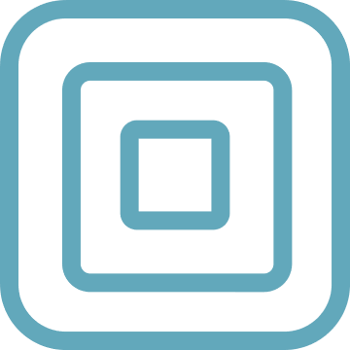
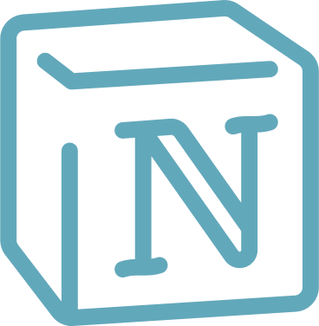
Learning Objectives
Understand web development basics with Python
Flask framework
Django framework
Gain practical experience
We will explore the Flask web framework for Python and use it to build the foundation of our blog application
We will move to the more advanced Django framework to leverage its additional features and build out a robust, full-featured blog app
Through hands-on work on a real blogging application, we will gain valuable practical experience in web development with Python
We will start by learning the fundamentals of web development using the Python programming language
By the end of this comprehensive study, we will have a solid understanding and practical experience in web development with Python, having built our own fully-featured blog application.

Slide 5
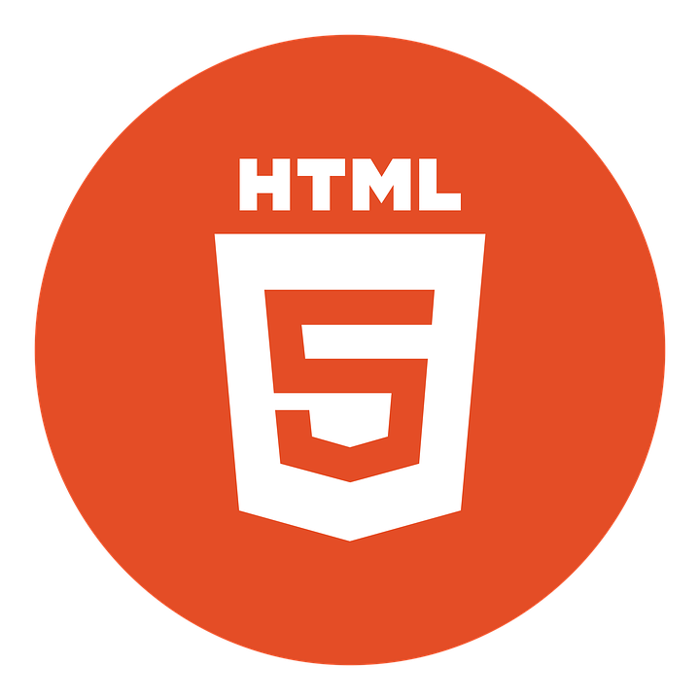
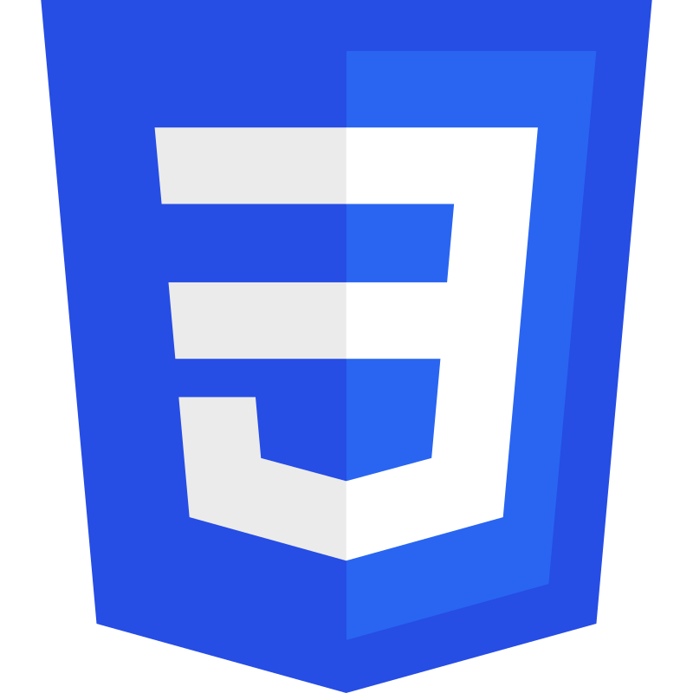
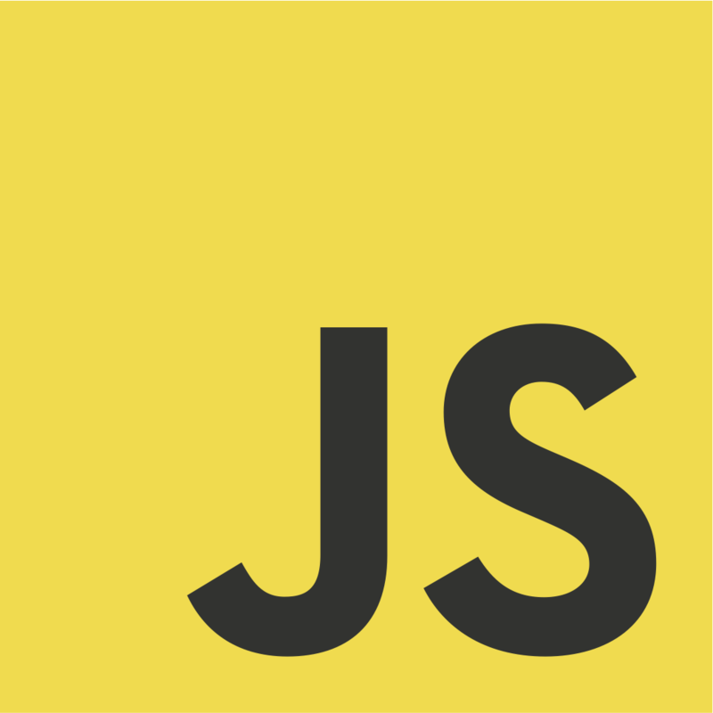
Front-end Basics
HTML
CSS
JavaScript
HTML is the standard markup language for building web pages and web applications.
CSS is used to style and layout web pages and web applications.
JavaScript is the programming language used to add interactivity and dynamic behavior to web pages and web applications.
HTML, CSS and JavaScript are the core front-end technologies for building web pages and web applications.

Slide 6
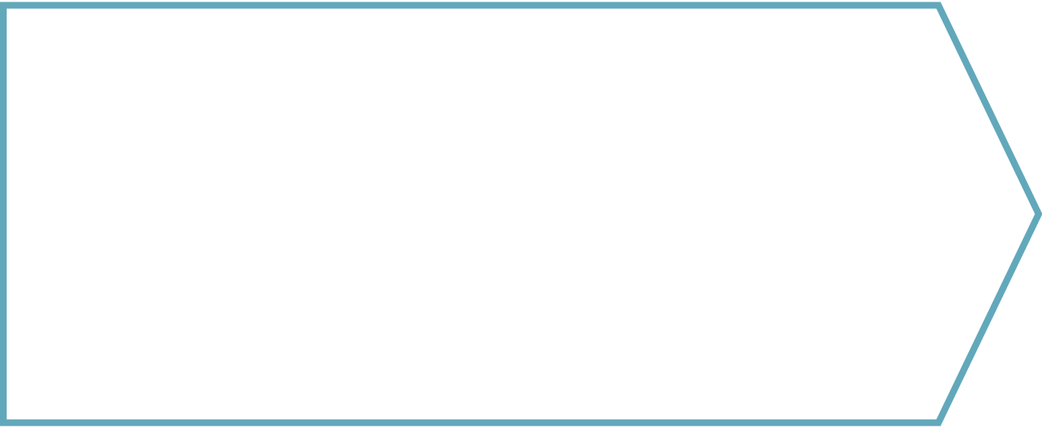
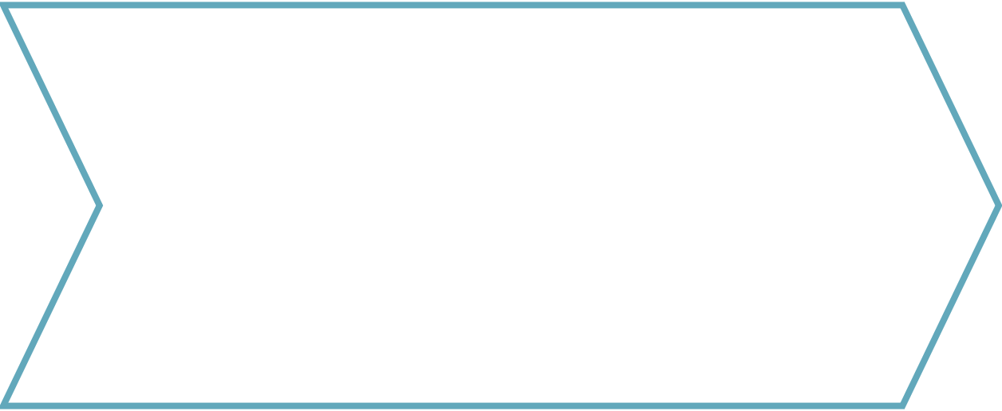
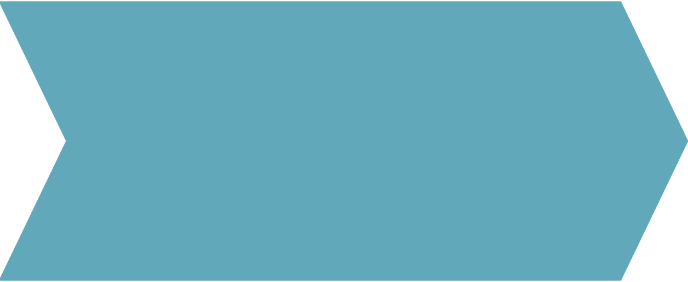
Back-end Coding
Install Python web frameworks like Flask or Django that provide tools for building web applications.
Map URL paths to Python functions that will handle requests and return responses.
Import database drivers and configure connections to databases like SQLite, MySQL, or PostgreSQL.
Create and activate a Python virtual environment to isolate project dependencies.
Set up Python virtual environment
Install web frameworks
Define URL routes
Connect to databases
Define models
Write API endpoints
Add authentication
Define Python classes that represent database tables and relationships.
Write functions that handle API requests, query the database, and return JSON responses.
Implement user registration, login, sessions, and protected routes.

Slide 7
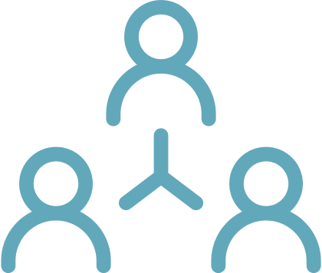
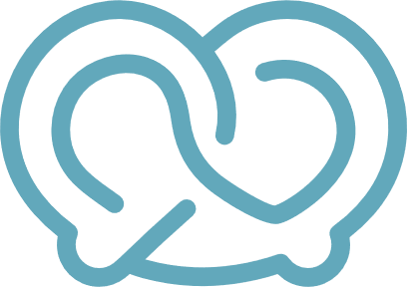
Flask
Flask is a lightweight Python web framework
Flask offers flexibility and simplicity
Flask has minimal setup and configuration
Developers can choose components a la carte instead of an all-or-nothing approach
Flask provides core web development tools without a lot of extra complexity
Getting started with Flask is quick and easy compared to larger frameworks
With its simplicity and flexibility, Flask is a great starting point for new Python web developers.

Slide 8
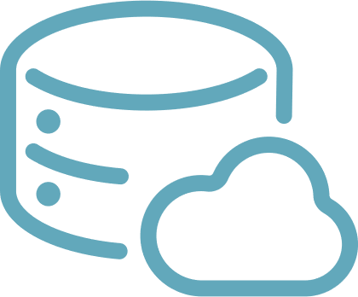


Building the Blog with Flask
Creating Blog Models
Setting up Views
Designing Templates
Integrating SQLite Database
Use Flask-SQLAlchemy to define Blog, Post, and User models
Use Flask blueprints and routing to map URLs to functions that render templates
Use Jinja syntax in HTML files to pass data and generate pages
Configure SQLite database and SQLAlchemy to persist models
By the end, we will have a simple but functional blog application with Flask

Slide 9


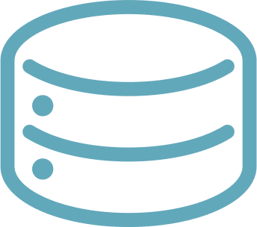
Django
Batteries included
MTV framework
Object relational mapper
Django comes with built-in components for databases, forms, user authentication, templates, etc. so you don't have to install a lot of extra packages.
Django follows the model-template-view architectural pattern. Models define data structures, views control logic, templates control presentation.
Django's ORM translates between database and Python objects automatically, allowing convenient database access.
Django's batteries-included philosophy and MTV framework make web development very rapid and convenient.

Slide 10



Building the Blog with Django
Define models with Python classes
Write views to handle requests
Use templates for UI rendering
Enable admin with one line
Django uses model classes to generate database tables
Views return HTTP responses for different URL routes
Django templates generate dynamic HTML with template language
The built-in Django admin provides UI for content management
Django's MVT structure and admin UI provide a rapid way to build full-featured web apps in Python.

Slide 11


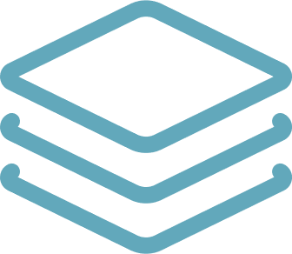
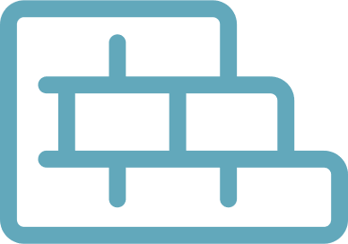
Building the Blog: Django vs Flask
Django provides batteries-included full-stack framework
Flask is minimal, flexible microframework
Django emphasizes conventions
Flask emphasizes modularity
Developers choose components like ORM, template engine based on needs
Provides structure through MVC pattern, project layout
Allows building incrementally based on requirements
Comes with ORM, admin interface, robust set of components out of the box
Django simplifies building full-featured apps quickly while Flask offers flexibility to customize based on needs.

Slide 12
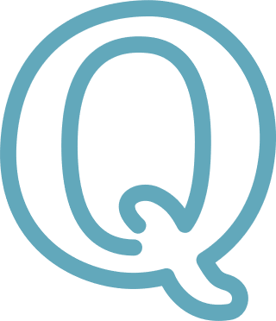
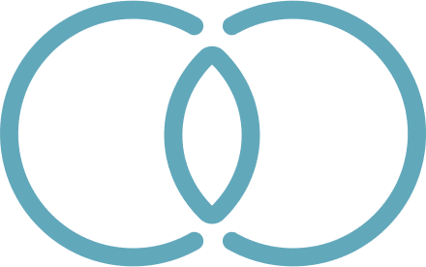
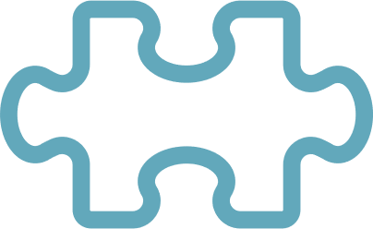
Similarities between Flask and Django
Both Python-based
MVC Architecture
Extensible
ORM Support
Flask and Django are built on Python, making them easy to use for Python developers
Both utilize the Model-View-Controller design pattern for clean code organization
Easy to extend functionality via third party libraries and plugins
Both provide Object Relational Mapping to simplify database interactions
Flask and Django share several key similarities that make them both suitable for web development in Python.

Slide 13
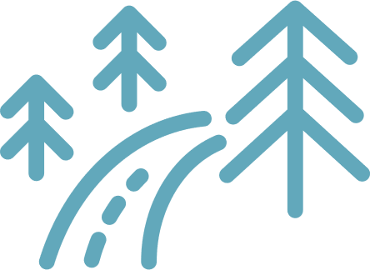
Differences between Flask and Django
Philosophy and complexity
Project structure
ORM and database
Admin interface
Flask has minimal conventions while Django enforces more structure
Django's ORM is more integrated while Flask's is more basic
Django has a built-in admin panel while Flask does not
Flask is simple and flexible while Django is more opinionated and structured
The key differences between Flask and Django highlight Flask's simplicity and flexibility versus Django's batteries-included structure and features.

Slide 14
Real-world Applications
Pinterest
LinkedIn
Twilio
Pinterest uses Flask for its simplicity and extensibility to customize and scale their web applications.
LinkedIn uses Flask in various microservices and apps due to its ease of use and adaptability.
Twilio uses Flask in their developer-friendly APIs and services due to its lightweight nature.
Netflix
Instagram
Spotify
Netflix has integrated Flask into their tech stack for certain microservices where a lightweight framework is suitable.
Instagram uses Django for its scalability and built-in admin interface to manage massive data and users.
Spotify uses Django's ORM system and admin interface to develop and manage their backend systems.

Slide 15

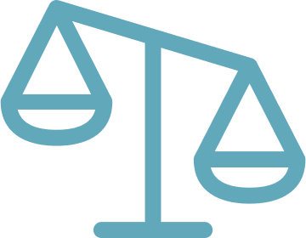
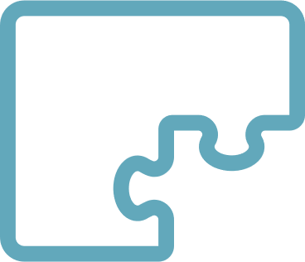
When to Choose Django
Rapid development
Scalability
Conventions
Django allows you to build a blog quickly with authentication, admin, and ORM.
Django has a structured framework to support growing complexity.
Django promotes conventions for consistent and comprehensive web development.
Django is a good choice when you need rapid development of a complex, scalable app that follows conventions.

Slide 16
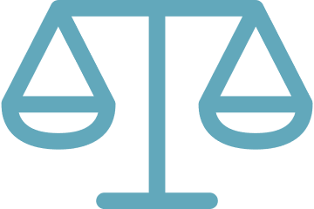
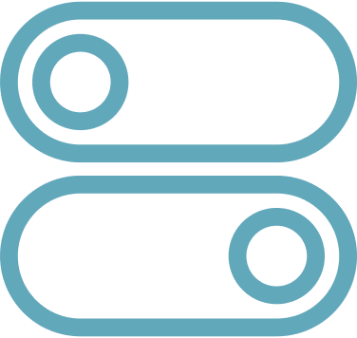
When to Choose Flask
Lightweight framework
Small to medium projects
Flexibility and control
Choose Flask if you prefer a lightweight web framework with flexibility.
Flask is a good option for small to medium sized web applications.
With Flask you have more control over components and can structure your project as desired.
Flask is a great option if you want a lightweight and flexible Python web framework.

